Slide 1
Chapter 17

Slide 2
Objectives

Slide 3
Objectives (cont.)

Slide 4
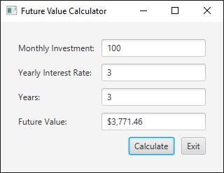
A GUI that displays 10 controls

Slide 5
Common GUI APIs for Java

Slide 6
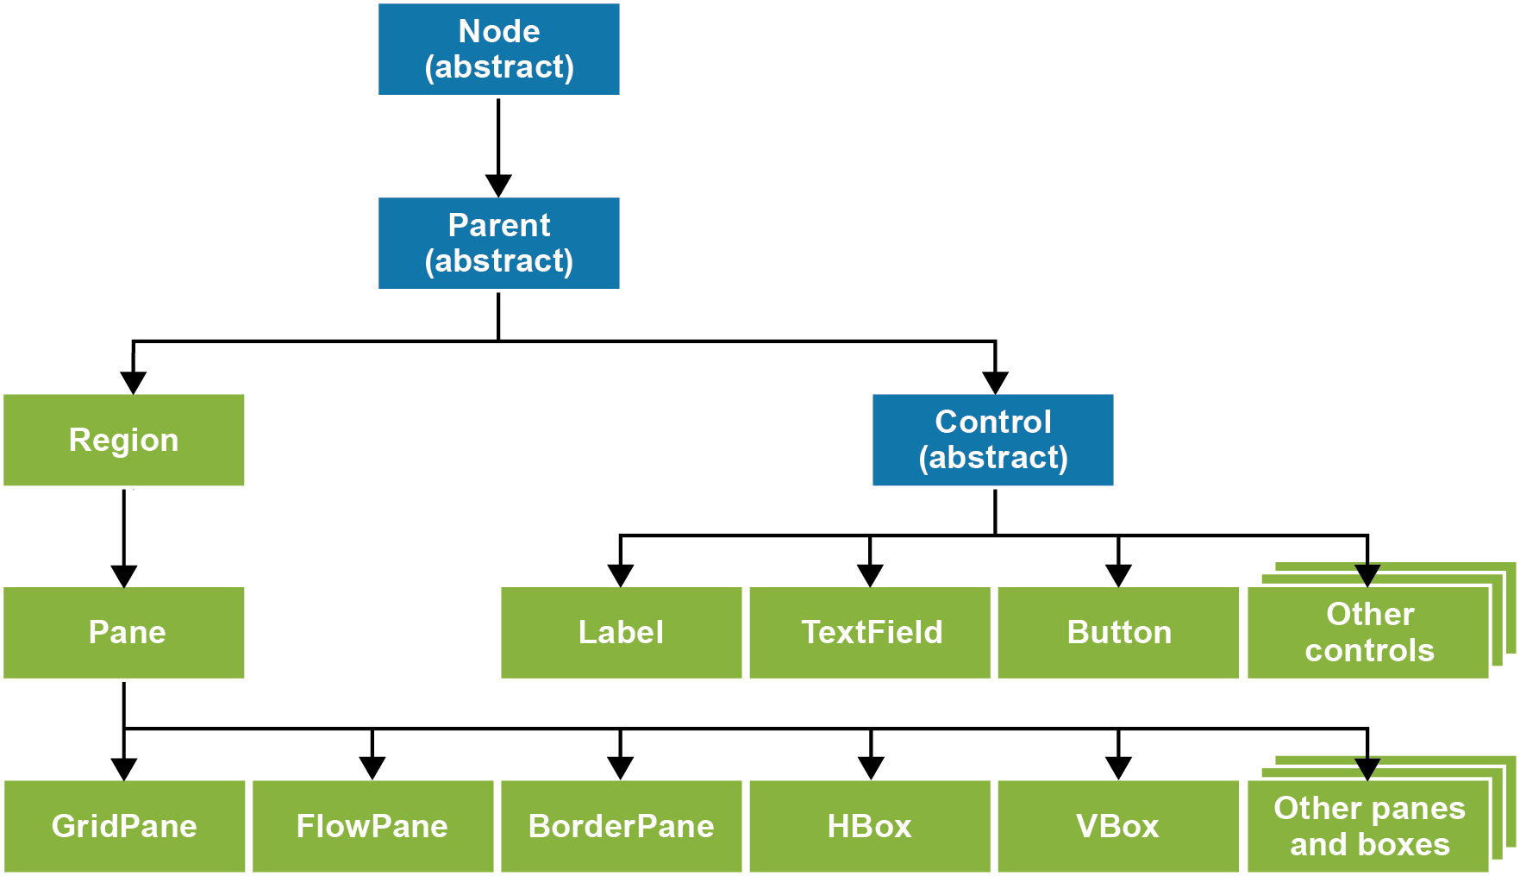
The inheritance hierarchy for JavaFX nodes

Slide 7
The layout managers

Slide 8
Constructors of the GridPane and Scene classes

Slide 9
A class that creates and displays an empty window

Slide 10
A class that creates and displays an empty window (cont.)

Slide 11
The package for controls

Slide 12
A method of the GridPane class for adding controls

Slide 13
Code that adds four labels to a grid

Slide 14
The package for working with alignment and padding

Slide 15
Code that sets the alignment and padding for a grid

Slide 16
The TextField class

Slide 17
How to create a text field

Slide 18
Code that adds four text fields to a grid

Slide 19
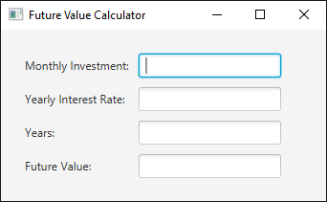
The resulting window with four text fields

Slide 20
The package for working with column widths

Slide 21
A method of the GridPane class for getting column constraints

Slide 22
The Button class

Slide 23
The HBox class

Slide 24
Another method of the GridPane class for adding controls

Slide 25
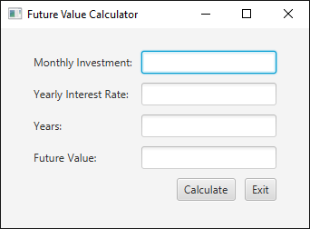
The resulting window with the two buttons

Slide 26
The package for working with events

Slide 27
How to add an event handler to a button

Slide 28
How to add an event handler to a button (cont.)

Slide 29

The GUI for the Future Value application

Slide 30
The FutureValueApplication class

Slide 31
The FutureValueApplication class (cont.)

Slide 32
The FutureValueApplication class (cont.)

Slide 33
The FutureValueApplication class (cont.)

Slide 34
The FutureValueApplication class (cont.)

Slide 35
The class for working with dialog boxes

Slide 36
Code that displays a dialog box with an error message

Slide 37
Code that checks if an entry has been made

Slide 38
Code that checks if an entry is a valid number

Slide 39
The code for the Validation class

Slide 40
The code for the Validation class (cont.)

Slide 41
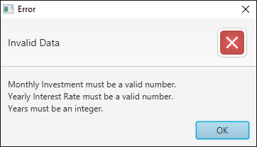
A dialog box that displays three error messages

Slide 42
Code that validates multiple entries

Slide 43
Code that validates multiple entries (cont.)

Slide 44
The products.xml document

Slide 45
Terms

Slide 46
Three files for an application that uses FXML

Slide 47
How to code the FXML file

Slide 48
How to access controls and supply event handlers in the controller class

Slide 49
The FXML file

Slide 50
The FXML file (cont.)

Slide 51
The FXML file (cont.)

Slide 52
The controller class

Slide 53
The controller class (cont.)

Slide 54
The application class

Slide 55
The application class (cont.)

